Slide 1

DESI: Tracking Digital Progress in EU Member States
Name: Preetam Shankar Malla
Student ID: 02031941

Slide 2
Prefix
The Digital Economy and Society Index (DESI) provides valuable insights into Europe's digital performance, allowing Member States to identify gaps and make informed policy decisions. However, raw data can be overwhelming and difficult to understand, which is where data visualization comes in.
By presenting data in a clear and visually appealing way, data visualization can help decision-makers understand complex information and identify trends and patterns. In this article, we will explore the importance of data visualization in digital transformation and discuss techniques for creating effective and impactful visualizations.

Slide 3
Key findings of DESI
Connectivity
Human Capital
Use of Internet
Integration of Digital Technology
Digital Public Services
Research & Development

Slide 4
Digital Economy and Society Index (DESI)
The DESI provides information on the European Union's policies, activities, news, library, funding, and consultations related to shaping Europe's digital future.
It includes information on the Digital Economy and Society Index (DESI), which summarises indicators on Europe's digital performance and tracks the progress of EU countries.
The DESI reports offer country profiles that help Member States identify areas requiring priority action, as well as thematic chapters providing a European-level analysis across key digital areas.
The report also highlights the EU's efforts to support digital transformation through significant resources and investments.

Slide 5
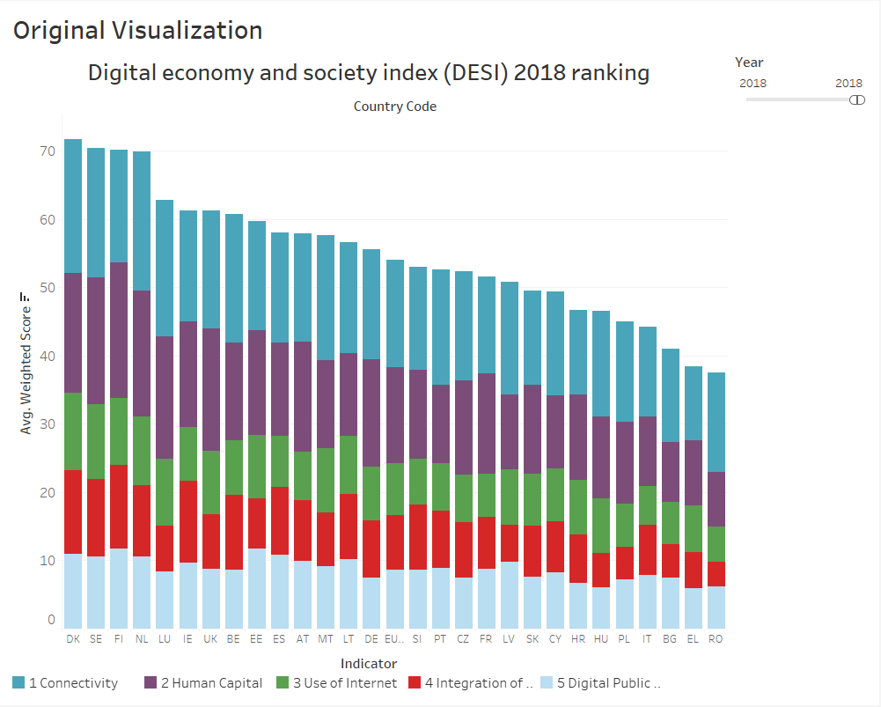
Statistics : Using Bar Chart
The bar graph show us the results of the
Digital economy of Europe in 2018.
Where, X axis = Country Code
Y axis = Weighted score.
In the bottom of the chart, it is the
indicator. Which let’s us know what
Different Color is.

Slide 6
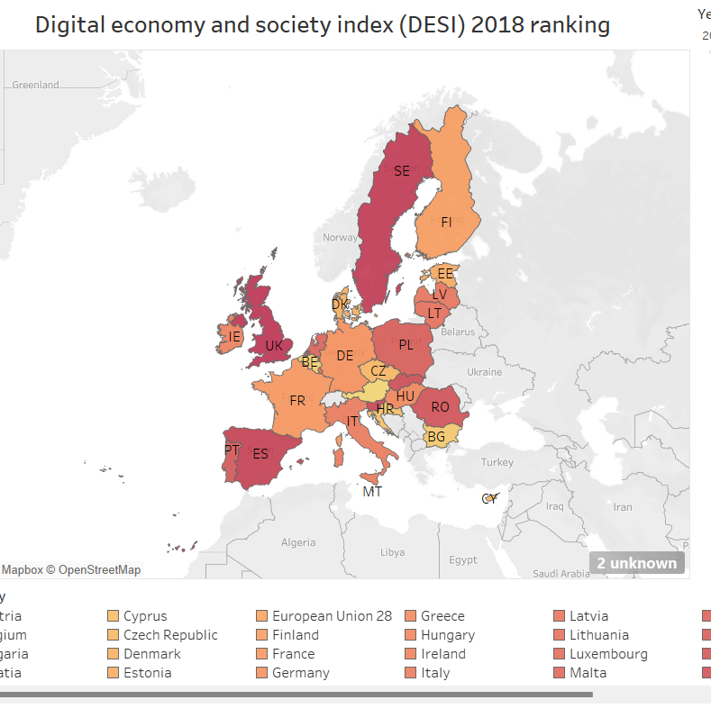
Statistics : Using Geospatial Representation
The Represented map show us the results of the Digital economy of Europe in 2018.
In this map Darker the color the higher the values. Lighter colors are with less values.
Labels are country code
In the bottom of the map, it shows us the countries with the color difference.

Slide 7
Why Geospatial ?
Geospatial map visualization is a powerful tool that allows us to represent and analyze data that is location-based.
Using geospatial maps, we can visualize data that shows its distribution across different regions.
Using geospatial maps, we can communicate complex data sets in a way that is easily understandable to a wide audience, including non-experts.

Slide 8
DESI 2018: Main Takeaways
As you can see from the geospatial map and the bar graph
Denmark, Sweden, Finland, and the Netherlands have the most advanced digital economies in the EU followed by Luxembourg, Ireland, the UK, Belgium and Estonia. Romania, Greece and Italy have the lowest scores on the DESI.
In 2017, all Member States improved in the DESI. Ireland and Spain progressed the most (close to 5 points as opposed to an EU average of 3.2). On the other hand, there was low increase in Denmark and Portugal (below 2 points).

Slide 9
Future
It is also feasible that future studies will add new indicators or modify existing ones to better reflect the changing digital world given the speed at which technology is developing. Future studies may, for instance, concentrate more on how cutting-edge technologies like artificial intelligence, blockchain, and the internet of things (IoT) are affecting society and the digital economy.

Slide 10
Why DESI is important for Europe?
The DESI report summarizes indicators on Europe's digital progress and tracks the progress of EU countries.
The DESI report summarizes indicators on Europe's digital progress and tracks the progress of EU countries.
The EU has dedicated significant resources to digital-related reforms and investments in the national Recovery and Resilience Plans, making it an unprecedented opportunity to accelerate digitalization, increase the Union's resilience, and reduce external dependencies.
Member States have been advancing in their digitalization efforts, but they still struggle to close the gaps in digital skills, the digital transformation of SMEs, and the roll-out of advanced 5G networks.

Slide 11
Reference
Digital Economy and Society Index 2018 Report | Shaping Europe’s digital future (europa.eu)
The Digital Economy and Society Index (DESI) | Shaping Europe’s digital future (europa.eu)
2019/W5: Digital Economy and Society Index (DESI) - dataset by makeovermonday | data.world

Slide 12
Thank you!!

